Slide 1

Pitch DECK
BY Christopher O’Brien

Slide 2
Character brief #1
For my first model I have chosen the Rookie Trainer (Type A) from Pouch Critters
The characters in pouch critters require a low-poly/cartoon style.
Pouch Critters is set in the region of Mandurah, it is a semi-rural coastal area in a hot, sunbaked part of the world. The region is semi-rural but has sci-fi features such as holographic projectors, farming robots and hover cars.
The rookie trainer is a newcomer to Mandurah, their goal is to become the number one critter trainer in the region.

Slide 3
Character #1 Style and purpose
Pouch Critters will be rendered in a cartoon-like/minimalist style, it uses bright colors with strong contrasts.
The models need to be simple and clean(low-poly to medium-ploy)
The models will consist of large flat surfaces with some detail to better communicate what the items are.

Slide 4
Character #1 Style and purpose
The Rookie Trainer will act as the Protagonist of the story, their Purpose/goal is to become the number one trainer in the region.
They act as a way for the player to explore the world of Pouch Critters and Battle other trainers.

Slide 5
Character #1 Profile
Name. Levi Ketchum
Type. Humanoid Sentient
Role. Protagonist (Player)
Profile.
- Masculine human child
- Between 10 and 12 years old
- A ‘rough and tumble’ type kid
- Backpack resembling a mix between a hiking pack and radio-backpack
- Belt with Critter Capsule slots & a fanny pack for even more storage

Slide 6
Character #1 Animations
The Rookie Trainer is a child and most likely active, so he will require many different animations, these animations may include.
A Walk Animation.
A Run Animation.
An Attack Animation.
A riding Hover Board/Surfboard Animation.
A Pass out Animation.
A laugh Animation.
A Catch Critter Animation.

Slide 7
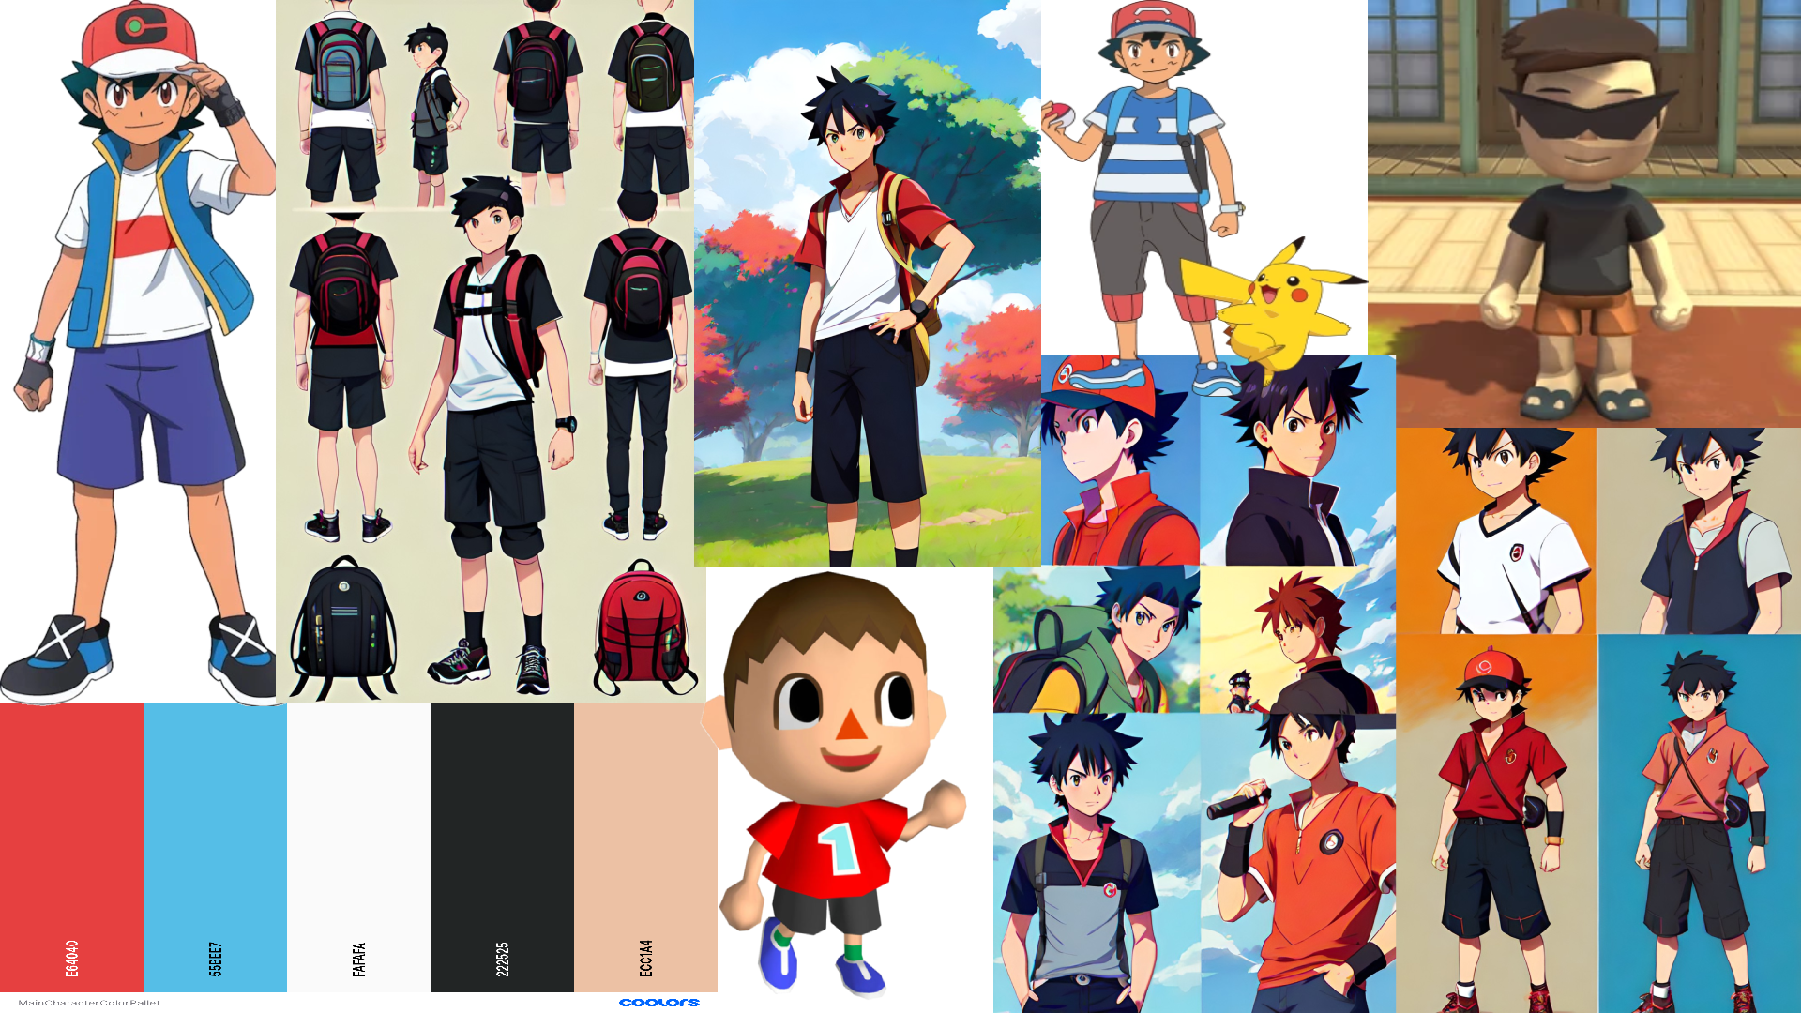
Character #1 Mood Board

Slide 8
Character brief #2
For my second model I have chosen the Giant Wolf from Antique Hoop
The characters in Antique Hoop require a High-poly/realistic style.
Antique Hoop is set in the Realms Betwixt, it is a stunning open world of decaying grandeur. It is filled with sprawling fields dotted with grand fortresses, mansions fallen to ruin and dark forests.
The Giant Wolf acts as an enemy for the player to defeat.

Slide 9
Character #2 style and purpose
The visual style for Antique Hoop will be realistic, though the elements being rendered are fantastical. Models will be high-poly.
Sombre, muted tones for flesh, fur, armour and weapons as well as buildings/manmade objects in the environment.
As a result of war and time, models are to be worn and damaged with little colour remaining.

Slide 10
Character #2 style and purpose
The Giant Wolf will act as an AI enemy type to the player.
The giant wolf purpose/goal to fight and try to kill the player on their journey through the world of Antique Hoop.

Slide 11
Character #2 Profile
Name. - Amarok
Type. – Non-Humanoid Sentient
Role. – Antagonist/AI enemy
Profile.
- A wolf the size of a horse
- Hugely muscled and intimidating
- Has three eyes

Slide 12
Character #2 Animations
The Giant Wolf will only require a few animations due to it being an NPC enemy, these animations may include
A Walk Animation.
A Run Animation.
A few Attack Animations.
A Death Animation.
A Jump Animation.

Slide 13
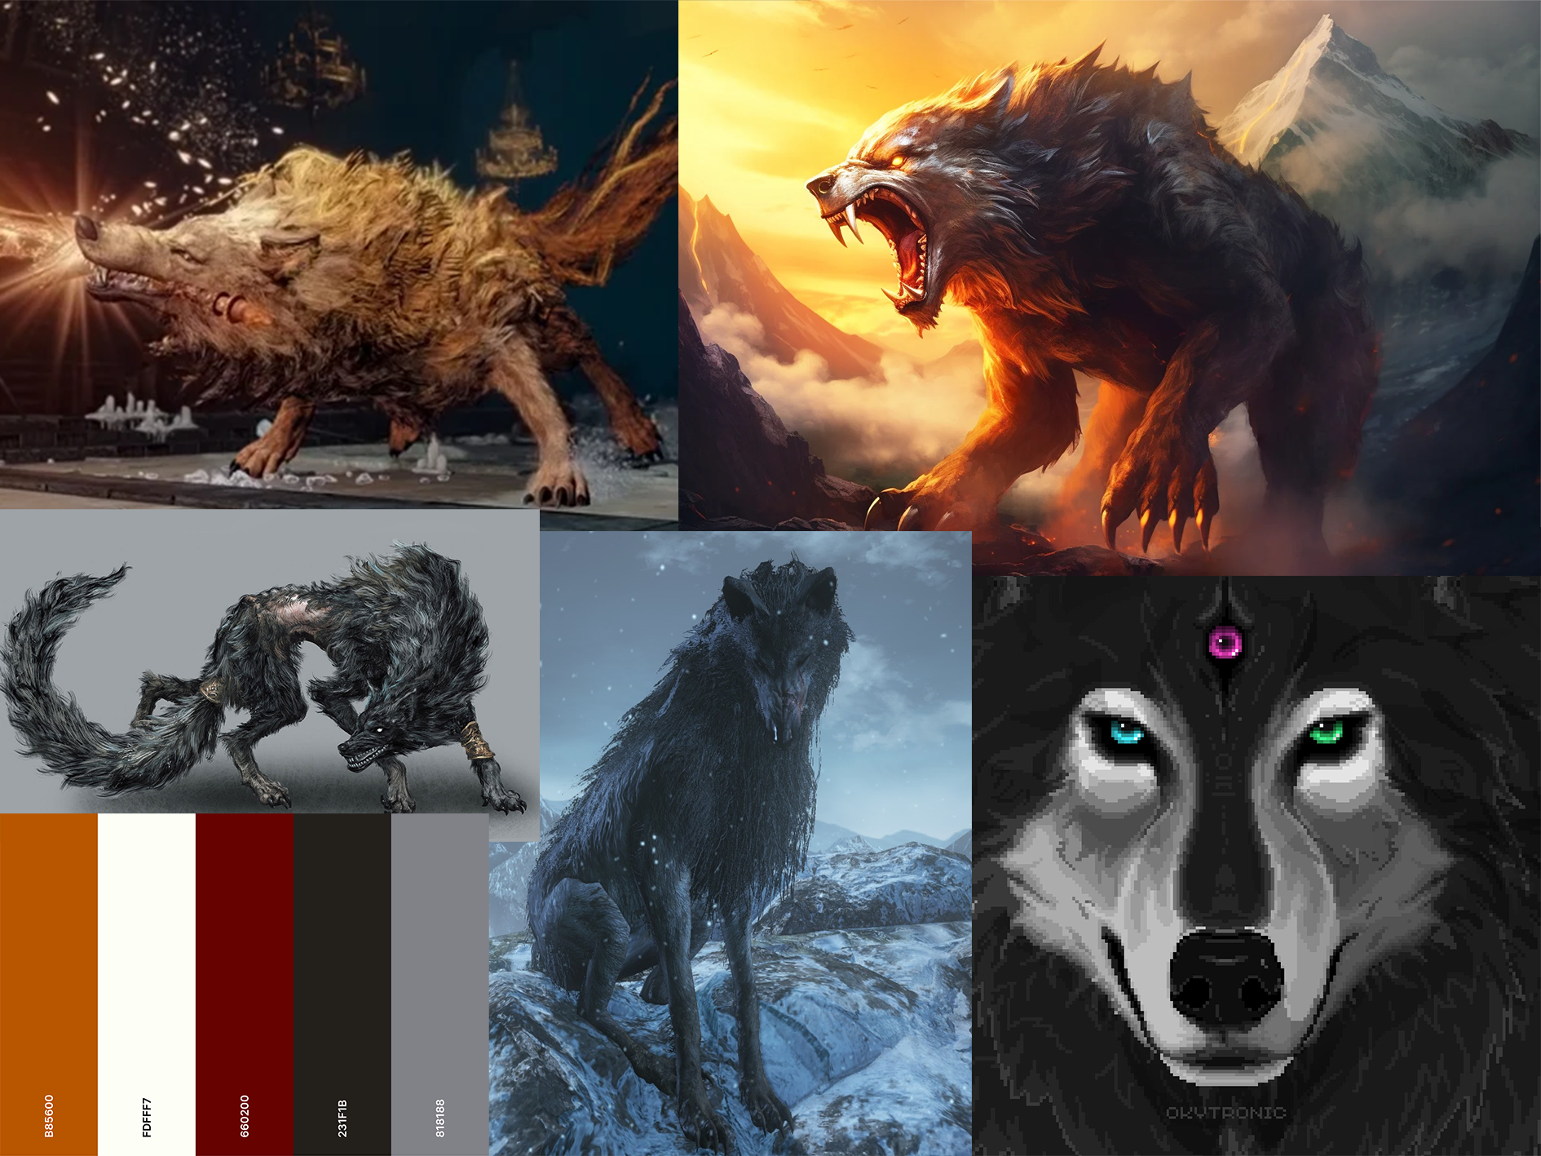
Character #2 Mood Board

Slide 14
ORGANIZATIONAL GUIDELINES
REQUIRED SOFTWARE.
This project requires tasks to be planned out and tracked throughout production, the required software would be a kanban board or Gannt chart to keep tasks organized.
WORKFLOW.
the workflow would start with research and creating concept art, then creating the first version of the model, the model would then be textured and animated, once that is done the model will be reviewed by testers, after feedback is received,
Final revisions will be made to the model before completion.

Slide 15
ORGANIZATIONAL GUIDELINES
ASSET NAMING CONVENTIONS.
All assets created in this project must follow proper naming conventions and be easy to understand, this might include the date of the file, the version, the format and a short descriptive name.
STORAGE/VERSION CONTROL.
To store files properly and to maintain version control, I will create a git repo to store all relevant files.

Slide 16
Production Schedule
Week 3 – start research for pitch deck
Week 4 – create pitch deck
Week 5 – present pitch deck
Week 6 – research and create concept art, plan out production.
Week 7 – create prototype model.
Week 8 – get feedback, texture and animate model.
Week 9 – make revisions and finalize model.
Due to delays this schedule may not be accurate to actual production.

Slide 17
Software Comparison
the two potential software I would use for this project are Blender and Maya
BLENDER - Blender is a 3D modelling software primarily built for small studios or people new to 3D modelling, it is free to use which makes it a good option for most people, it has a large community and many tutorials on YouTube which makes it very easy to learn also it is quite easy to learn without tutorials due to its simple interface.
PROS –
- It is free to use.
- Many tutorials make it easy to learn.
- Good for indie devs.
- Has all basic tools needed.
CONS –
- Not very advanced.
- Limited in its capabilities.
Maya is a professional 3D modelling software,
Maye is built for large studio projects; it costs quite a lot to use but the capabilities of it are much better than blander. Maya can be used for modelling, sculpting, animating, texturing and more, it is much harder to learn but it is worth it in the end.
PROS –
- Larger toolset.
- Better for large scale projects.
CONS –
- High price.
- Hard to learn.
- Lack of documentation and tutorials.

Slide 18
Chosen Software
For this project I have chosen to use Blender, as it is better suited to my needs, because it is free to use, easy to learn and has all the basic functionality needed for this project, such as block modelling, sculpting, texturing, animation and more.

Slide 19
Project Documentation
To maintain documentation and task management throughout the project there are a few different application I can use such as, a production diary, Gantt charts and kanban boards.
I will be using kanban boards through Hack n Plan because I am familiar with the software, and I may also create a production diary for additional documentation.

Slide 20
Thank YOU

